Slide 1
Business Pitch
Author
Institutional Affiliation
Instructor
Course code
Date of submission

Slide 2
Business Pitch
Admittedly, milk is considered an essential and nutritious food commodity for humans providing essential elements in the human diet.
In this view, milk is considered the cheapest source of animal protein, however, most countries in the Middle Eastern region do not have the capacity to maintain sufficient internal production of milk consequently requiring external supply of milk products in this region.
The region’s climatic conditions significantly limit its abilities in milk production. Syria and UAE experience a serious challenge of milk shortage despite the considerable increase in the per capita income in these countries.
Observably, there is a problem because the demand for milk products has outgrown the internal supply of milk products in this region.

Slide 3
The solution to this problem as identified in this proposal is to import milk products from milk-rich countries like Australia to address the deficit.
For this reason, Sydney Instant Milk Powder Company seeks to export milk powder products which would provide essential dietary elements required for the sustenance of livelihoods.
Currently, the milk market segment in the Middle East is worth about 455 million dollars and is expected to reach 700 million dollars by 2023.
Sydney Instant Milk powder is thus expected to compete favorably in this market because the company ideally specializes in the manufacture of quality milk powder products that is made from pure, fresh, homogenized and pasteurized cow milk.

Slide 4
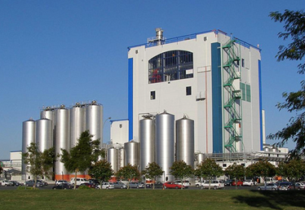
An image showing a milk processing plant

Slide 5
Australia is recognizably a world agricultural center, known for its expertise in agriculture and production of high quality produce.
Similarly, the country’s products are known to safe and nutritious besides being of high quality.
In this sense, the country’s dairy products are observably no exception and would bring relief to the Middle East countries where there are many limiting factor for the expansion and development of milk production from cows and other dairy animals.

Slide 6
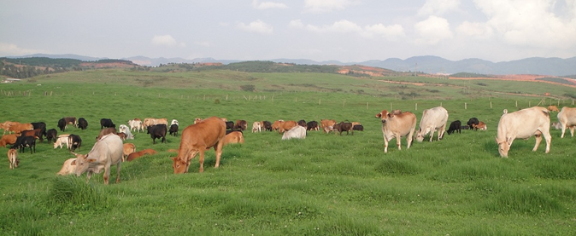
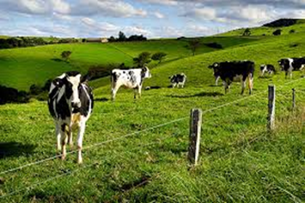
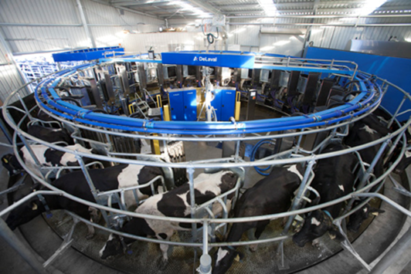
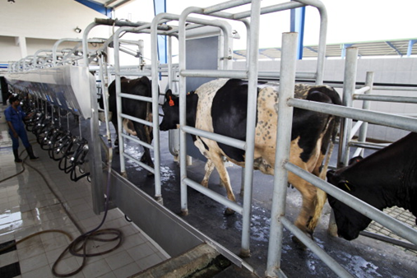
Images showing the safe conditions in which Australian cattle are reared

Slide 7
In order to gain higher customer’s purchase intentions, Sydney Instant Milk company would apply the use of TV commercials to particularly help in building trust in the mind and perception of the customers.
Believably, as evidenced in Khuong & Nguyen (2015), building of positive attitudes and moods is directly associated with the buying intention of the customers.
And because the sale of milk powder products represents the major source of income for the company, building the customer’s trust and enhancing interest would be a major factor of consideration.

Slide 8
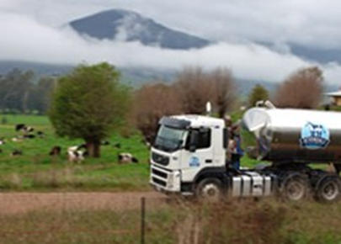
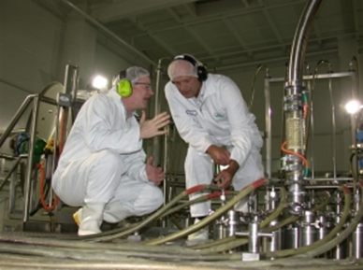
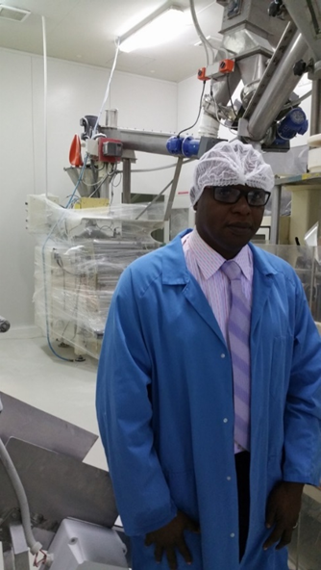
Sydney Milk Powder is packaged under strict conditions that comply with Australian and international standards ensuring our product is the highest quality suitable for export
Manufacturing and packing of our milk powder meets the high standards required by the Dairy Industry Food Act, Export Control (Milk & Milk Products) HACCP & GMP.

Slide 9
Drinking milk and use of powdered milk has indicated a strong performance in other middle eastern countries such as Syria and Lebanon over the recent years.
UAE is also witnessing a gradual growth attributed to the increase in awareness in health awareness regarding the benefits of milk.
In the other middle eastern countries, due to the increased focus on healthier food alternatives the demand has drastically shifted from fresh milk to powdered and other forms of processed milk because these are considered healthier and more nutritious.
Applying a differentiated market strategy, the company’s targeted market would be all over UAE and Syria, focusing particularly on the working population

Slide 10
